Slide 1

Automation Inequality
Forecasting Global Trends
By Nancy Ezzeddine
Notes:
“Automation is transforming industries and economies around the world, promising massive gains in productivity, efficiency, and innovation.”“However, not all regions and economies are equally prepared to leverage these benefits, leading to a growing gap in automation adoption.”
“High-income countries are surging ahead, while low-income regions face challenges that hinder their ability to keep pace. This ‘automation divide’ has implications for global economic equality.”
“Our research explores this divide, examining how economic and technological readiness influence automation levels across different countries.
“Our goal is to predict future automation levels across regions and countries, identifying the key factors driving automation adoption.”
“By understanding these drivers, we can help guide strategies to close the gap, ensuring that automation benefits aren’t limited to certain parts of the world.”

Slide 2
Importance of Understanding Automation
Why Automation?
Transforming Industries: Automation and AI are reshaping industries, impacting millions of jobs worldwide. As adoption accelerates across sectors, understanding automation’s effects has become increasingly crucial.
A Complex Process to Measure
Evolving Technology: Automation is not a single event; it’s an ongoing transformation with varied impacts across industries, regions, and job types. This complexity makes measuring and predicting its effects a challenge.
Bridging the Divide Between Developed and Developing Regions
Identifying Key Drivers: By analyzing the drivers of automation, we can anticipate its impacts and create pathways to manage them. Without equitable automation processes, the gap between developed and developing regions could widen significantly, deepening economic and social divides.
Notes:
Automation is A Complex Process to Measure:
“Automation isn’t a one-time event; it’s an ongoing evolution with different impacts across sectors, regions, and job types. This makes it challenging to measure and predict accurately.”
“As technologies evolve and new tools are introduced, the nature of automation itself shifts. This complexity is why a robust, data-driven approach to tracking automation trends is essential.”
“Using machine learning models and economic analysis, we analyzed global automation data and extrapolated future trends up to 2030, focusing on the role of economic factors and technological readiness.”
“Let’s dive in”

Slide 3
Project Objectives
1. Identify Automation’s Impact Across Industries and Regions
1
2. Understand Key Drivers of Automation
2
3. Predict Automation Levels to Monitor Progress
3
4. Bridge the Global Automation Gap
4
Notes:
So we have four goals for the next 12 minutes:
"Our first goal is to understand how automation is impacting different industries and regions. By analyzing which sectors are most susceptible to automation-driven job disruptions, we can pinpoint areas that might face the greatest shifts in employment."
"The second objective is to examine the factors that drive automation adoption. This includes investment in AI, workforce skill levels, and overall economic conditions."
"By identifying these drivers, we can see what elements contribute to a region’s readiness for automation and, more importantly, what might be holding back certain regions or industries from advancing."
"Our third objective is predictive. We developed a machine learning model that can forecast automation levels across different countries. This allows us to track advancements and delays in real-time, giving policymakers a tool to monitor automation growth."
"Finally, we aim to bridge the global automation gap. The insights from this study are designed to guide policies and training initiatives that help reduce the disparities in automation adoption between developed and developing regions."

Slide 4
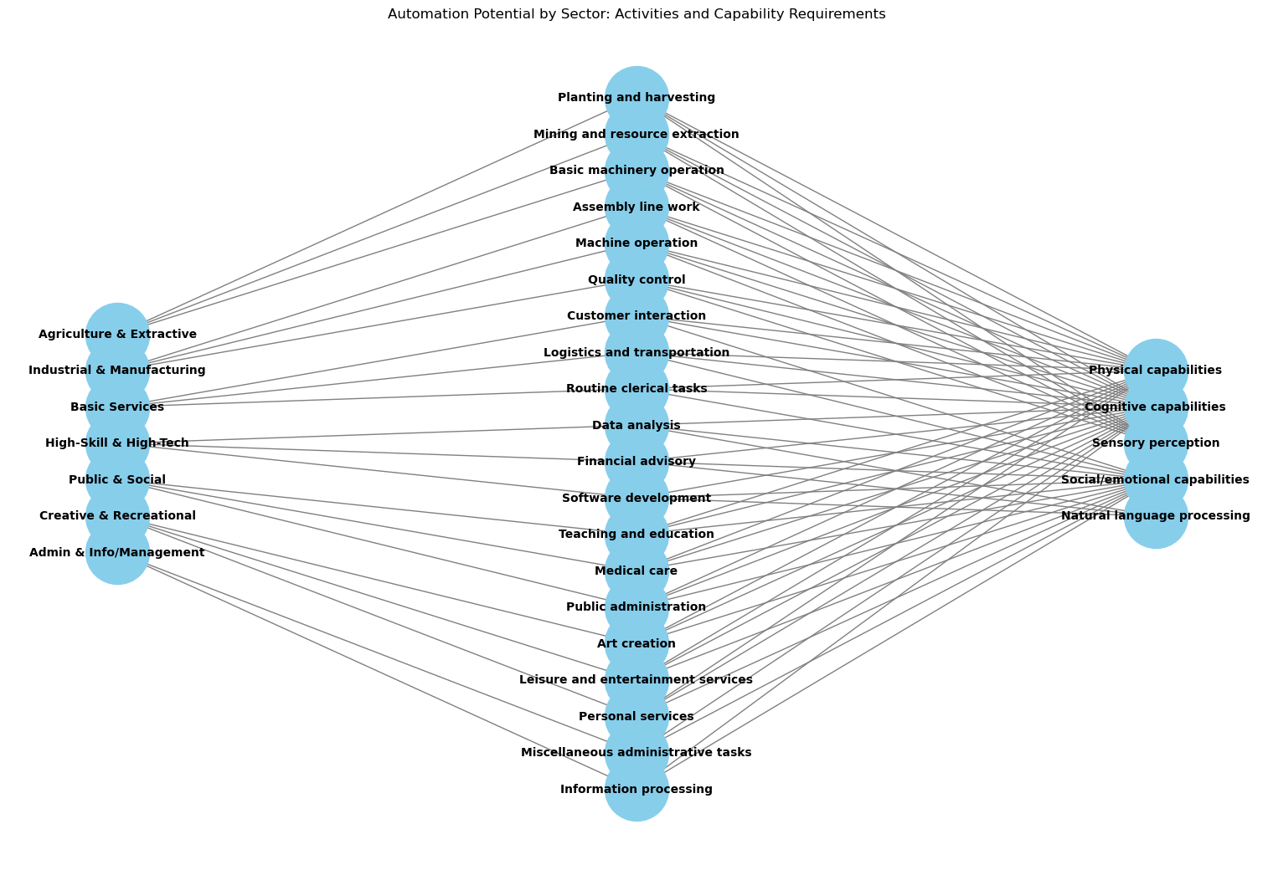
Measuring Automation Potential by Sector
Approach: We assess each sector’s automation potential by identifying the number and type of tasks that can be automated.
Methodology: Automation potential is determined based on the prevalence of tasks requiring specific capabilities, like cognitive or physical skills.
Notes:
1.To understand automation’s impact across sectors, we break down the automation potential by analyzing tasks rather than entire occupations.
2.Automation potential varies not only by industry but also by the specific tasks within each job role.
1.Based on a McKinsey’s methodology, I reattempt calculating the automation potential for each sector by identifying tasks that could feasibly be automated with current or emerging technologies.
2.Tasks are analyzed in terms of five key capability requirements: (here in the image you see a sample of sectors, tasks, and capabilities)
1.Physical capabilities: Tasks requiring physical activity, often involving repetitive or structured movements.
2.Cognitive capabilities: Tasks involving logical decision-making, data analysis, and processing.
3.Sensory perception: Tasks requiring perception of the physical environment, often critical in jobs involving quality control or assembly.
4.Social/emotional capabilities: Tasks involving interpersonal interaction, such as customer service or team-based activities.
and so on
2.For example:
1.Agriculture & Extractive industries rely heavily on physical and sensory capabilities, making many tasks here potentially automatable.
2.High-Skill & High-Tech sectors involve a lot more cognitive and social capabilities, which are currently less automatable.
1.By focusing on tasks instead of entire occupations, we can better estimate which sectors will see the earliest adoption of automation.
2.This approach also allows for more precise predictions of the skill gaps and workforce transformations required across industries.

Slide 5
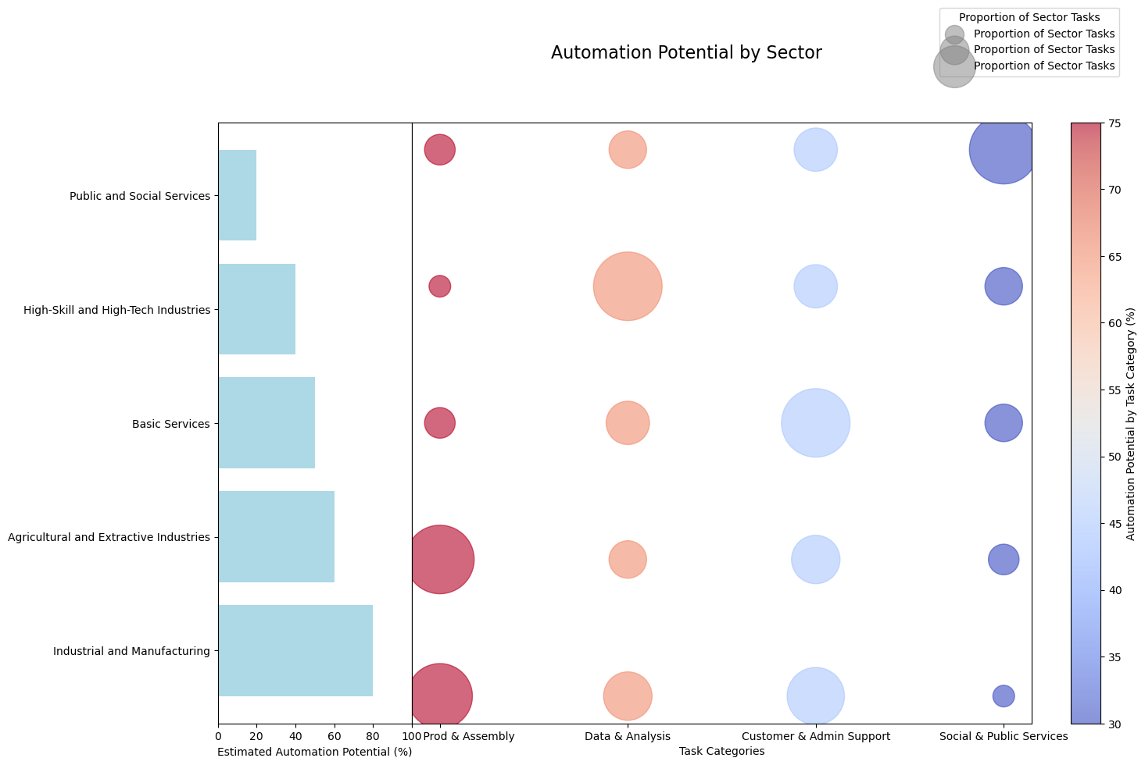
Notes:
So we apply this approach by using employment data per sector globally to get both the automation potential per sector and per task, and here are some results: Ill give you a minute to read the figure (you read it once)
1.Based on current technology, nearly 49% of all activities in the global economy have the potential to be automated. However, it’s important to note that while tasks can be automated, less than 5% of entire sub-sectors or occupations within sectors can be fully automated, highlighting that jobs will evolve rather than disappear entirely.
1.Automation is highly feasible for predictable tasks like data processing, physical labor, and machinery operation. These tasks are common in sectors such as Manufacturing and Agriculture, which show some of the highest automation potential.
2.For instance, factory roles with tasks like welding and soldering have an automation potential of over 90%, while customer service roles, which require interpersonal skills, have a lower susceptibility (less than 30%).
1.Tasks involving stakeholder interactions, complex decision-making, and creativity show significantly lower automation potential due to the nuanced human skills required. This is why sectors like public and social services and Creative Arts remain less automatable.

Slide 6

Automation Potential by Sector
Global Automation Potential: Approximately 49% of activities that people are paid to do in the global economy could be automated using current technology.
Sector Variation in Automation: In Manufacturing and Agriculture, automation potential is high (up to 90% for predictable physical tasks), while it’s much lower in sectors requiring human interaction and complex decision-making.
Impact on High-Wage Occupations: Automation potential spans all levels, from low-skill to high-skill jobs. Even CEOs have tasks with about 25% automation potential, particularly for data processing and report analysis.
Global Economic Impact: Technically automatable activities could affect 1.1 billion jobs globally, representing $15.8 trillion in wages, with the greatest impact likely in economies with large labor forces, such as China, India, the United States, and Japan.
Notes:
1.Interestingly, both high-wage and low-wage jobs have automatable components. Even at the executive level, about 25% of a CEO’s tasks—such as data analysis and report review—are automatable. This shows that automation can touch every level, emphasizing the need for skill diversification across occupations.
1.Globally, automatable activities could affect 1.1 billion employees and a staggering $15.8 trillion in wages. The largest impacts are expected in countries with large labor forces, China and India, France, Germany, and several African countries.

Slide 7
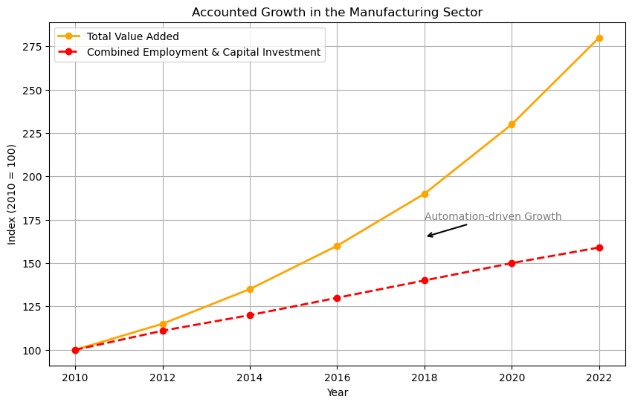
Measuring Actual Automation Levels
Composite Index for Automation: We created an index to measure actual automation levels by analyzing sector growth that isn’t explained by traditional inputs—labor, capital, and natural resources.
Why This Approach?: By isolating growth driven by automation, we can more accurately track automation adoption across sectors and regions, offering a real-time indicator of progress and identifying sectors lagging in automation.
Notes:
Now instead of potential (hypothetical) we try to gfind a way to measure actual level of automation achieve this far in countries across the globe.
The index provides a tangible way to gauge automation by focusing on growth not tied to traditional input factors, such as labor, capital, and natural resources.
2.This approach allows us to capture productivity gains directly attributed to automation technologies.
2.Why Isolating Inputs Matters:
1.Traditional sector growth (an example of the manufacturing sector is provided in this figure) can be due to various inputs: increased labor (more workers), additional capital (investment in machinery, facilities), or natural resources (raw material availability).
2.By filtering out growth from these sources, our index hones in on automation as the driver of productivity gains, providing a clearer picture of where automation is advancing.
In this figure it is the difference between these two lines.

Slide 8
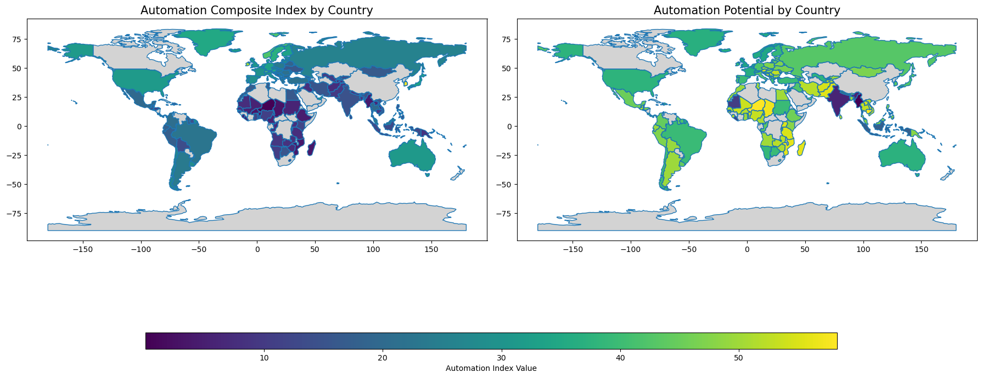
Notes:
So here we have plotted both measures at the same time.
•By comparing actual automation levels (left) to automation potential (right), we can identify which countries are fully leveraging their automation capabilities and which are lagging behind.
•This analysis provides insights into where gaps exist between current automation adoption and theoretical potential, highlighting opportunities for growth.
Key Observations:
•In many developed regions (e.g., North America, Western Europe), actual automation levels closely match automation potential, indicating high adoption of automation technologies.
•Conversely, some developing regions, particularly in Africa and parts of Asia, show significant automation potential but low actual automation levels. This gap suggests barriers such as limited access to capital, insufficient infrastructure, or workforce skill mismatches.
you will notice missing values - keep that in mind we will get to it later.

Slide 9
Comparing Automation Potential vs. Actual Automation Levels
Automation Composite Index vs. Automation Potential: The maps illustrate the difference between actual automation levels (composite index) and the theoretical automation potential across countries.
Key Insight: Countries with high automation potential but low actual automation levels may face delays in capturing productivity gains, highlighting areas where investments or policy interventions are needed.
Global Disparities: Differences between potential and actual automation adoption reveal gaps in readiness, influenced by factors like infrastructure, investment, and workforce skills.
Notes:
Purpose of Comparison:
By comparing actual automation levels (left) to automation potential (right), we can identify which countries are fully leveraging their automation capabilities and which are lagging behind.
This analysis provides insights into where gaps exist between current automation adoption and theoretical potential, highlighting opportunities for growth.
Key Observations:
In many developed regions (e.g., North America, Western Europe), actual automation levels closely match automation potential, indicating high adoption of automation technologies.
Conversely, some developing regions, particularly in Africa and parts of Asia, show significant automation potential but low actual automation levels. This gap suggests barriers such as limited access to capital, insufficient infrastructure, or workforce skill mismatches.
Implications for Productivity and Economic Growth:
Countries with high automation potential but low actual automation levels may struggle to achieve the productivity gains that automation can offer, potentially widening economic disparities globally.
For these countries, investing in technology, training, and infrastructure could accelerate automation adoption, allowing them to capture missed productivity benefits.
Guidance for Policymakers and Industry Leaders:
Policymakers can use this analysis to prioritize investments in sectors or regions with high automation potential but low adoption, fostering an environment where automation-driven growth can be realized.
Industry leaders can focus on reskilling and infrastructure development in lagging regions to help close the gap between potential and actual automation, supporting balanced global growth.
Conclusion of Comparison:
Understanding the difference between automation potential and actual automation levels helps us pinpoint where automation is underutilized. Bridging these gaps could lead to significant productivity gains and more equitable economic development globally.

Slide 10
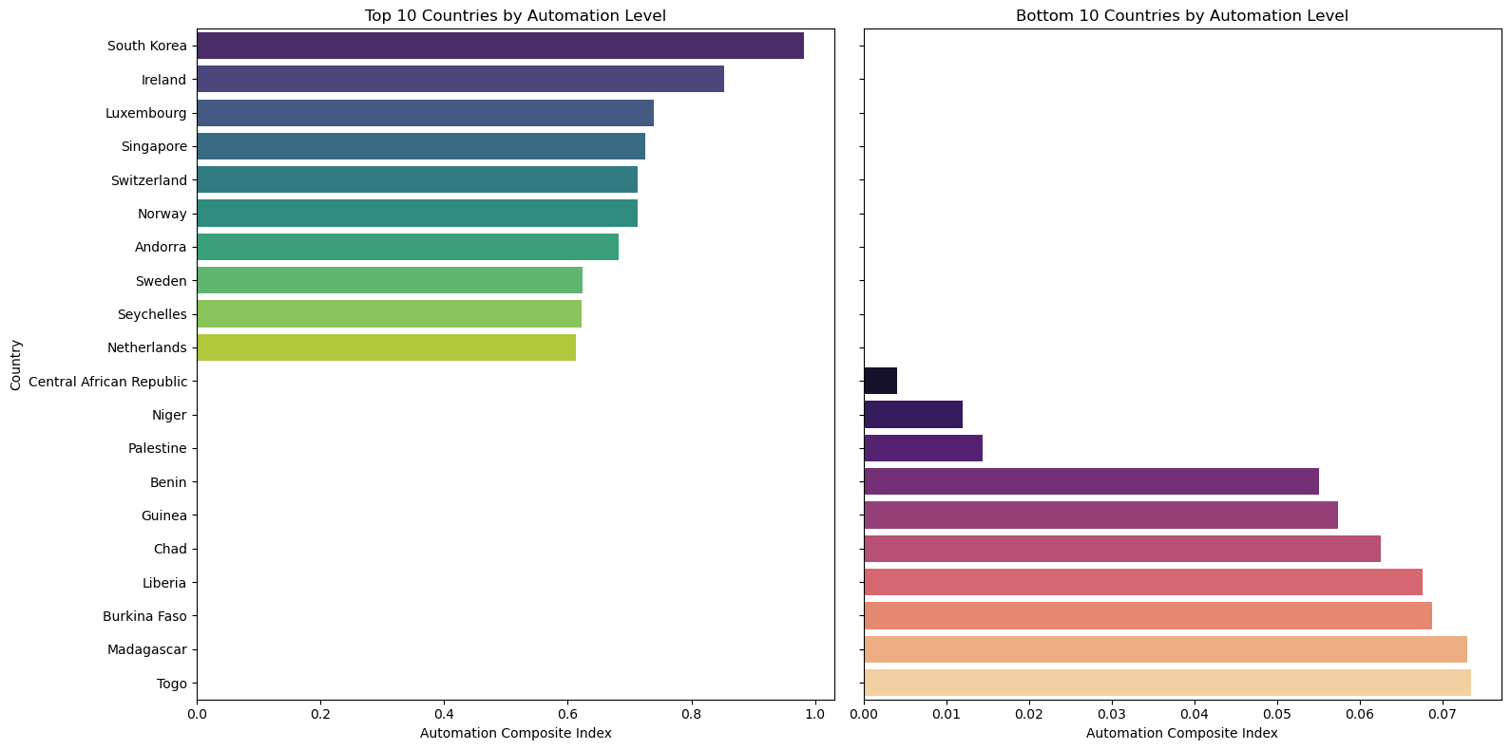
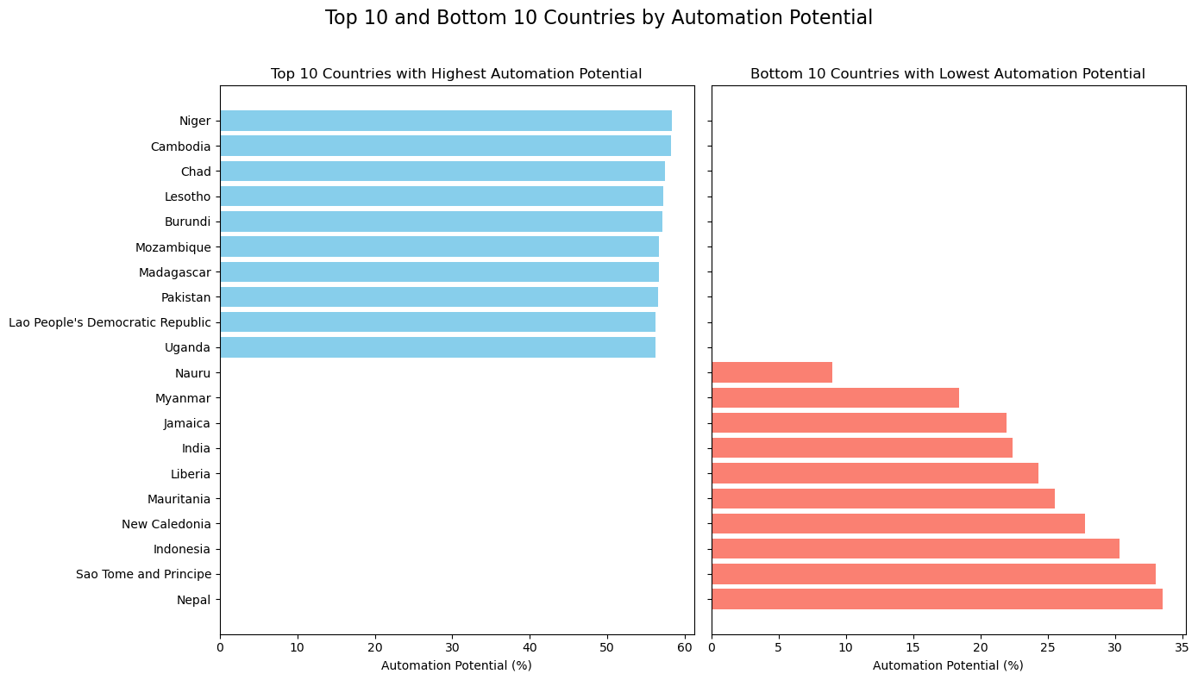
Comparing Automation Potential
Uneven Adoption: High automation potential does not guarantee high actual automation levels across countries.
Key Disparities: Developing countries often show high potential but low adoption, while top adopters effectively capitalize on their potential.
Notes:
To see the data more granularly, here we have the top 10 and bottom 10 countries with automatiton potential and automation adoption
•Countries like Niger, Chad, and Cambodia have high automation potential due to the types of tasks present in their economies, but their actual automation levels are low.
•South Korea, Singapore, and Ireland are leading in actual automation levels, closely aligning their high potential with strong adoption rates.
•These countries benefit from advanced infrastructure, significant investments in technology, and a skilled workforce, allowing them to fully capitalize on automation benefits.

Slide 11

Predicting Future Automation Levels
Our Goal: To understand and close the gap between automation potential and actual automation adoption, we developed a machine learning model to forecast future automation levels across regions.
Why This Matters: By identifying what drives automation, we can better support regions at risk of falling behind and guide targeted interventions for balanced global development.
Notes:
- “The primary goal of our project is to understand and bridge the gap between a region’s automation potential and its actual level of automation adoption.”
- “To achieve this, we developed a machine learning model that forecasts future automation levels, helping us see where automation is likely to grow and where it may lag.”
- “This forecast is more than just a prediction. By identifying the key drivers of automation, we gain insights into what regions need to enhance their automation adoption.”
- “This understanding enables targeted interventions, particularly for regions at risk

Slide 12
Introducing Our Explanatory Variables
EconomIC Indicators: GDP per capita, investment in technology, education spending, and other economic health indicators.
Labor Market Characteristics: Employment rates by sector, skill levels, wages, and workforce composition.
Infrastructure & Technological Readiness: Availability of digital infrastructure, AI and automation investments, internet penetration, and R&D activity.
Policy and Regulatory Environment: Government support for automation, labor market regulations, trade policies, and automation incentives.
Human Capital: Education levels, skill distribution, training programs, and adaptability of the workforce.
Notes:
We looked at a lot of research that could point us in the right direction here are some categories of variables we have looked at
1.Economic Indicators:
provide a baseline for a country’s economic health and capacity to support automation, including metrics like GDP per capita, technology investment, and education spending.
2.Labor Market Characteristics:
captures the makeup of the workforce, including sector-specific employment rates, skill levels, and wage data, which are crucial for understanding how ready the workforce is for automation.
3.Infrastructure & Technological Readiness:
1.Covers the foundational technologies needed for automation, such as digital infrastructure, internet penetration, and AI investment,
4.Policy and Regulatory Environment:
1. includes government policies and incentives that either support or hinder automation, along with labor regulations and trade policies
5.Human Capital:
1.Measures workforce skills, education levels, and access to training programs

Slide 13
Introducing Our Explanatory Variables
Explanatory Variable | Source
GDP per capita | World Bank
Labor force participation rate (% of total population) | International Labor Organization
Individuals using the internet (% of population) | International Telecommunication Union
Research and development expenditure (% of GDP) | UNESCO
Percentage of graduates from STEM in tertiary education | UNESCO
ICT good imports (% of total good imports) | UNCTAD
Governance indicators | World Bank
Global connectiddness | DHL
Foreign Direct Investment (net inflows) | International Monetary Fund
Notes:
We ended up using more than 13 explanatory variables here is a sample
why im showing this is to elude to the complex methodology of retrieving, cleaning, and merging the data.
- We sourced data from multiple international databases to ensure a comprehensive view of the factors influencing automation adoption

Slide 14
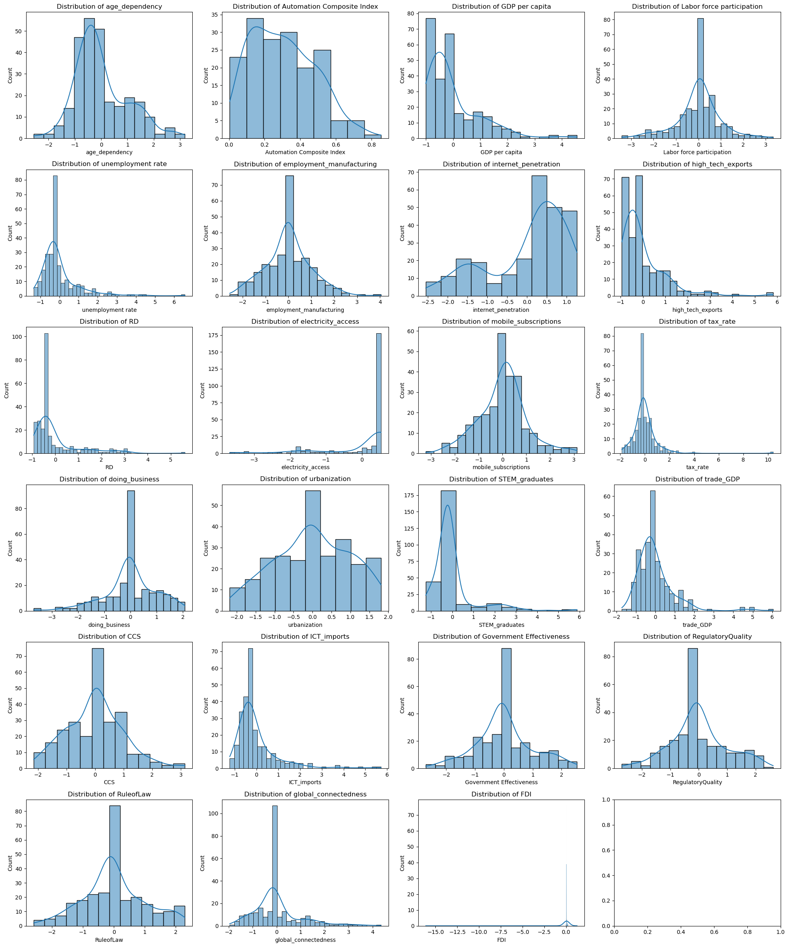
Step 1: Data Preprocessing
Standardization: Ensures all variables are on a similar scale, allowing for fair comparison across features.
Handling Missing Values: Used K-Nearest Neighbors (KNN) to estimate missing values by finding countries with similar characteristics.
Transformation of Skewed Data: Adjusted skewed distributions and outliers to improve model accuracy.
Notes:
Datapreprocessing some of the things we have done:
1.Standardization:
1.Standardizing the data means converting each variable to a similar scale, often with a mean of 0 and a standard deviation of 1.
2.This step is essential here because our dataset includes variables with vastly different units
3.Standardization helps ensure that no single variable dominates due to scale differences
2.Handling Missing Values with KNN: (there were quite a few missing values because as much as we tried to get data for everything we cant)
1.We used the K-Nearest Neighbors (KNN) method to fill in missing values. This approach identifies countries with similar profiles (in terms of economic indicators, technology levels, etc.) to estimate missing data points.
3.Transformatied our distribution of our variables.
1.Many variables in the dataset were highly skewed or had outliers, which can distort the model’s predictions.
2.We applied transformations (like log or square root transformations) to normalize these distributions, helping the model process the data more effectively.
and reduces the influence of extreme values

Slide 15
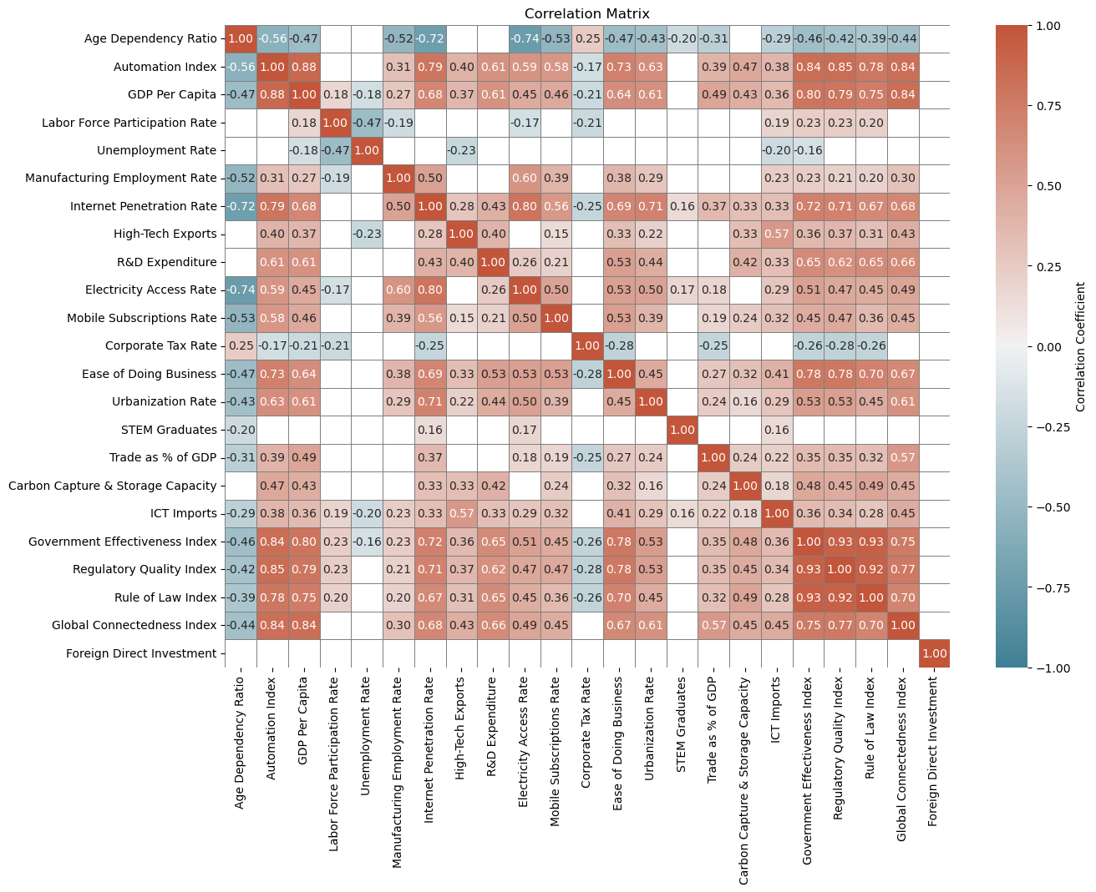
Step 2: Feature Engineering
Feature Selection: Using a correlation matrix, we identified relationships among variables to select the most predictive features while minimizing redundancy.
Refining Inputs: Chose features with high correlation to the target variable (Automation Index) and low multicollinearity with each other to enhance model accuracy and efficiency.
Key Insights: Variables like GDP per capita and Internet Penetration Rate show strong positive correlations with automation levels, while Age Dependency Ratio has a negative correlation.
Notes:
1.Purpose of Feature Engineering:
1.Feature engineering refines our dataset by selecting the most relevant features, reducing noise, and focusing on variables that add the most predictive power for our model.
1.The correlation matrix provides a clear view of relationships among variables, helping us identify features that are strongly associated with the target variable (Automation Index).
2.By examining both the strength and direction of correlations, we could make informed choices on which variables to retain or exclude.
1.Variables like GDP per capita, Internet Penetration Rate, and R&D Expenditure showed strong positive correlations with the Automation Index, indicating they are key drivers of automation adoption.
4.Minimizing Multicollinearity:
1.We avoided including features that are highly correlated with each other, as this can introduce redundancy. For example, Regulatory Quality Index and Government Effectiveness Index (which book look at governance) were carefully reviewed for overlapping impacts.
2.Reducing multicollinearity ensures each feature provides unique information, enhancing model performance.

Slide 16
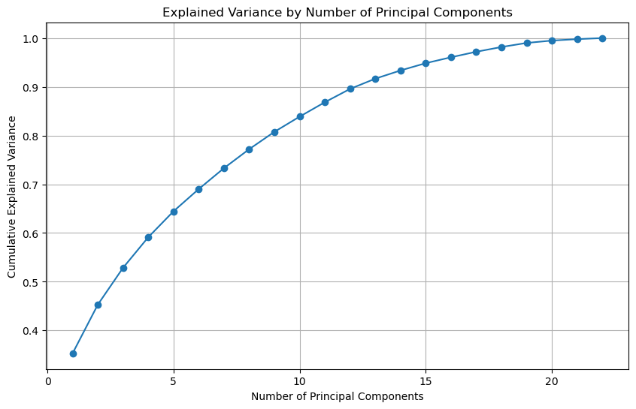
Step 3: Dimensionality Reduction
Principal Component Analysis (PCA): Applied to reduce dimensionality and identify key drivers of automation.
Explained Variance Plot: Shows how many components are needed to capture most of the dataset’s variance.
Top Features in PC1: Global connectedness, GDP per capita, regulatory quality, government effectiveness, rule of law, R&D.
 | PC1 Loading
Global Connectedness | 0.354771
GDP per capita | 0.321058
Regulatory Quality | 0.318923
Government Effectiveness | 0.317672
Rule of Law | 0.309666
Research & Development | 0.280795
Ease of Doing Business | 0.250445
High Tech Exports | 0.242847
Computer and Communication Service Imports | 0.214729
Internet Penetration | 0.188169
Urbanization | 0.182527
Trade | 0.179337
ICT Imports | 0.160448
Labor Force Participation | 0.153029
Electricity Access | 0.127463
Mobile Subscription | 0.124179
Employment in Manufacturing | -0.004813
STEM Graduates | -0.032023
Age Dependency | -0.062897
Foreign Direct Investment | -0.094489
Unemployment Rate | -0.117613
Tax Rate | -0.128092
Notes:
Purpose of the Principal Component Analysis (PCA) helps reduce the number of features by combining correlated variables into principal components, making the dataset more manageable while preserving the information needed for accurate predictions.
1.The cumulative explained variance plot for example helps us decide how many principal components to retain. Each point on the curve represents the cumulative variance explained by adding another component.
2.In our plot, we see that the first few components capture a significant portion of the variance. By around 10 components, we capture over 85% of the variance, meaning we can achieve a robust representation without needing all original features.
3.Key Insights from PC1:
1.The first principal component (PC1) accounts for a major part of the variance and is heavily influenced by variables such as global connectedness, GDP per capita, regulatory quality, government effectiveness, rule of law, and R&D.
2.These variables are strong drivers in distinguishing automation potential across countries, capturing the economic, regulatory, and connectivity factors that facilitate automation.

Slide 17
Step 4: Model Selection
 | Model | RMSE | R² | MAE
1 | Lasso | 0.189225 | -0.013950 | 0.159014
2 | ElasticNet | 0.189225 | -0.013950 | 0.159014
3 | RandomForest | 0.063746 | 0.884929 | 0.042442
4 | LinearRegression | 0.067408 | 0.871328 | 0.040845
5 | GradientBoosting | 0.077255 | 0.830991 | 0.053604
6 | Ridge Model (with hyperparameters) | 0.0663 | 0.8754 | 0.0412
Choice of Models: Given the complexity of relationships between our features and target variable, we tested both linear and non-linear models to find the best fit for predicting automation levels.
Best Performing Model: The Random Forest model achieved the highest R2R^2R2 score (0.8849) and a low RMSE (0.0637), making it the most accurate for our data.
Other Model Insights: While linear models like Ridge Regression and Linear Regression performed reasonably well, non-linear models like Random Forest and Gradient Boosting provided better flexibility to capture complex interactions.
Notes:
1.We began by testing a mix of linear and non-linear models, as our data likely contains both linear trends and non-linear relationships between features and the automation index.
2.Linear models (like Ridge and Linear Regression) are simpler and effective for straightforward relationships, while non-linear models (like Random Forest and Gradient Boosting) can capture more complex interactions.
2.Model Performance:
1.The Random Forest model emerged as the best-performing model with the highest R2R^2R2 (0.8849), indicating a strong ability to explain variance in the target variable.
2.It also had the lowest RMSE (0.0637) and MAE (0.0424), showing that it makes precise predictions with minimal error.

Slide 18
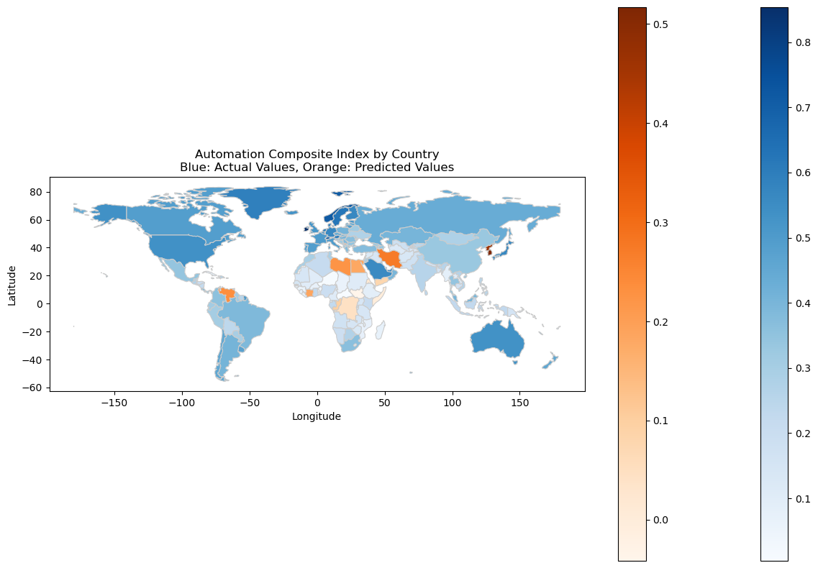
Step 5: Model Application
Objective: We predicted automation levels for countries without existing automation data using our trained model.
Map Insights: Blue regions represent actual values, while orange regions show predicted values. This approach fills gaps in the global automation landscape, aiding cross-country analysis and targeted policy-making.
Notes:
So now we apply the model and the first use is to fill in the countries with missing data we saw earlier on the maps.
By applying our model, we can estimate these values, providing a more comprehensive global view of automation readiness and adoption.
You can see these predictions in the red-orange gradient legend on the map

Slide 19
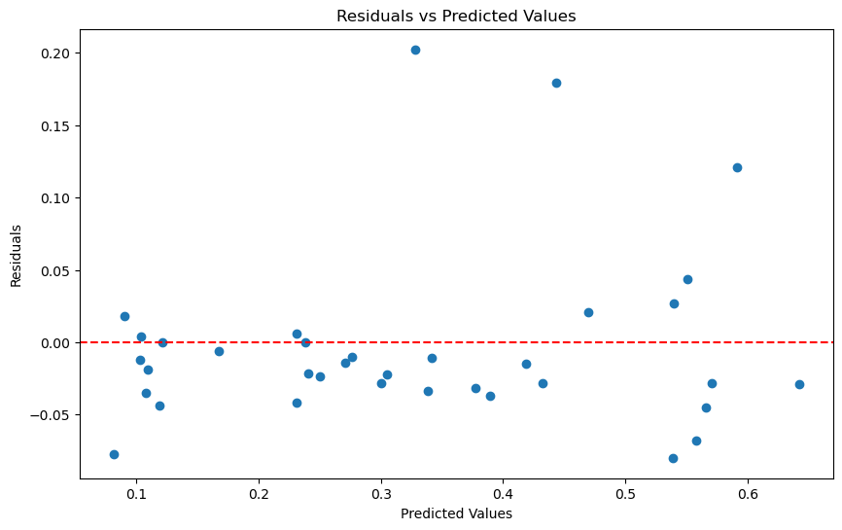
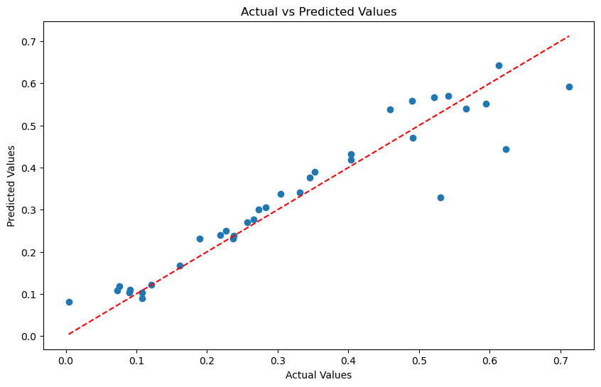
Model Improvement
Evaluation Results: The model performed well in predicting automation levels, showing strong alignment between actual and predicted values.
Areas for Improvement: We observed some residual patterns, indicating potential improvements in data or model complexity.
Future Enhancements: Consider advanced models, feature refinement, and more data to enhance accuracy.
Notes:
“Our model performed relatively well in predicting automation levels, as we see a strong alignment between actual and predicted values.”
“The scatter plot shows this alignment, with most points closely following the red line, indicating accurate predictions in many cases.”
“However, we identified some areas where the model could be improved. The residual plot shows patterns in the residuals—these are the differences between actual and predicted values.”
“Ideally, residuals should be randomly scattered around zero, but we can see some patterns, especially at higher predicted values. This suggests potential improvements in our data or the complexity of the model.”
“To further improve accuracy, we are considering exploring more advanced models, such as ensemble methods or neural networks, which could capture deeper patterns in the data.”
“Another enhancement could be refining our feature set to focus on the most impactful variables and gathering additional data to better represent automation trends across more countries and sectors.”

Slide 20
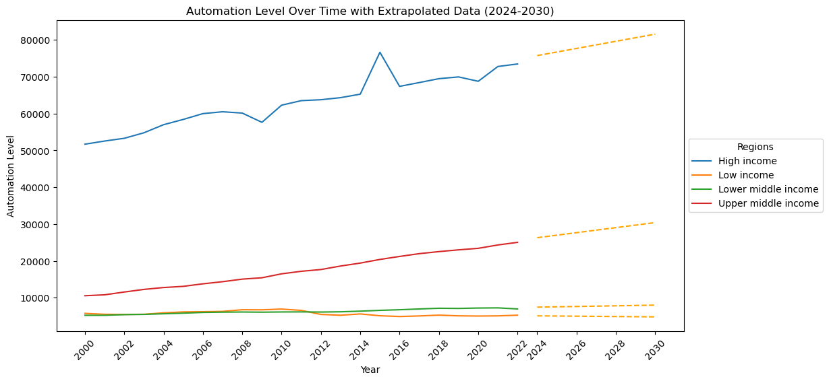
Extrapolated Automation Levels (2024-2030)
Objective: With Linear Regression performing well and economic indicators strongly influencing automation, we extended automation projections across income groups to 2030.
Results: High-income regions show the most significant automation growth, while low-income and middle-income regions lag behind.
Implications: If current trends continue, the automation gap between high-income and low-income regions may widen, potentially increasing global inequalities.
Notes:
•Given that Linear Regression captured automation trends effectively and that economic indicators (like GDP per capita) were key explanatory variables, we applied a linear extrapolation to estimate future automation levels across different income groups.
•This analysis helps us anticipate how automation adoption might evolve up to 2030, highlighting potential disparities between regions.
•High-income regions (blue line) show robust growth in automation levels, reflecting strong infrastructure, investment, and economic readiness.
•Upper middle-income regions (red line) display moderate growth, but the gap with high-income regions is projected to expand over time.
•Lower middle-income and low-income regions (green and orange lines) exhibit minimal growth, and projections suggest only slight increases by 2030. Limited resources and infrastructure in these regions hinder their capacity for automation adoption.
•If current trends persist, the automation gap between high- and low-income regions will likely widen. High-income regions will continue to benefit from automation’s economic advantages, while lower-income regions may struggle to keep up, affecting their global competitiveness.
•This widening gap could exacerbate global inequalities, as automation strengthens economic growth in high-income countries while potentially leaving lower-income regions further behind.
•This projection highlights the critical need for proactive measures to address disparities in automation adoption. Without intervention, automation could reinforce existing socio-economic inequalities, impacting global economic balance and inclusivity.

Slide 21
Thank you for listening, Nancy Ezzeddine

